Slide 1
Video Segmentation by Non-Local
Consensus Voting
Alon Faktor & Michal Irani
The Weizmann Institute of Science
Published at BMVC’14
Notes:
Hi, I am Alon Faktor and this joint work with Michal Irani,
Video Segmentation by Non-Local Consensus Voting

Slide 2
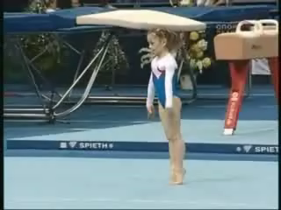
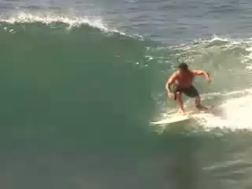
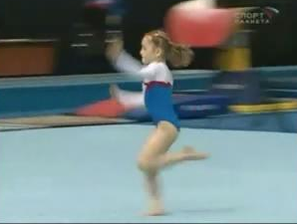
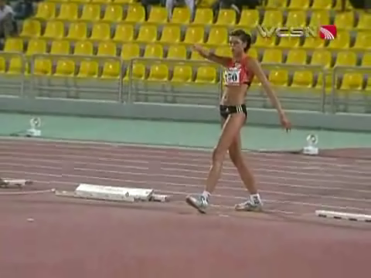
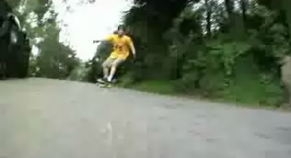
Goal: Segment video into fg\bg
Severe Motion Blur
Non-rigid Background Motion
Non-rigid foreground Motion
3D parallax
Notes:
So What is the problem we are trying to solve.
Given a video sequence, our goal is to consistently seperate between
the foreground moving objects and the background.
And we want to obtain even of the video is very uncontrained. Meaning that it may contain Non-rigid Background Motion, Severe Motion Blur, 3D parallax and Non-rigid foregound motion.
video segmentation has been widely addressed in the vision
community for more than two decades. Recent methods include:
Trajectory-based methods, which obtain segmentation by long-term motion cues. However, these are limited to constrained scenarios with quite slow motions (in order for optical flow to be relaible). Even in these scenarios, there are still over-segmentation problems.

Slide 3
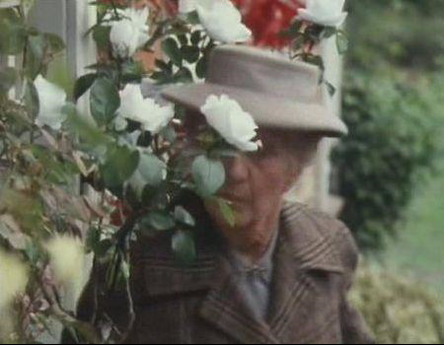
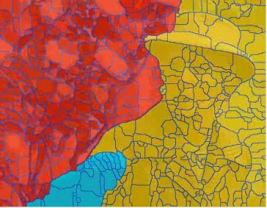
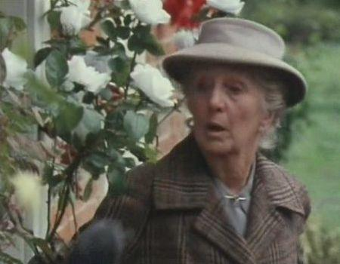
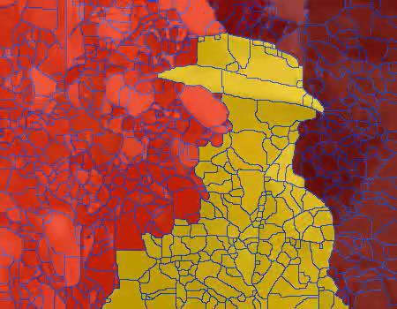
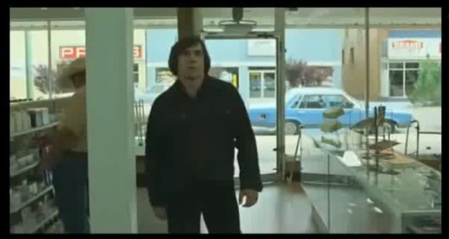
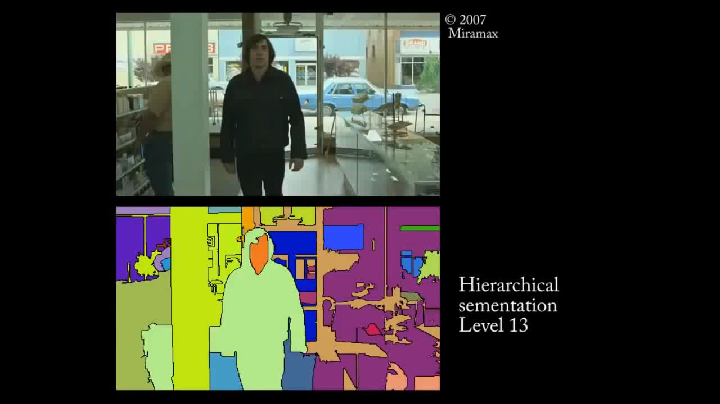
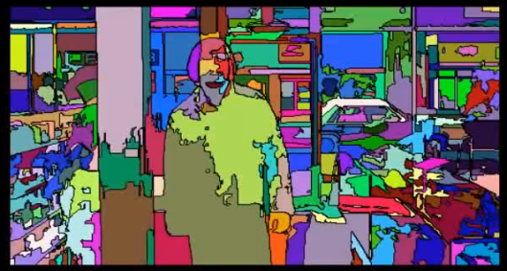
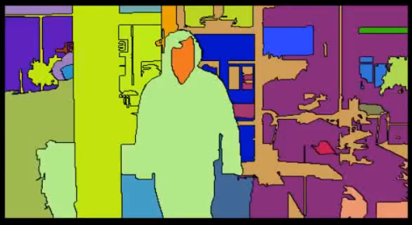
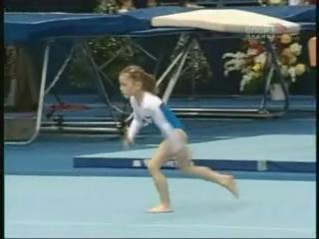
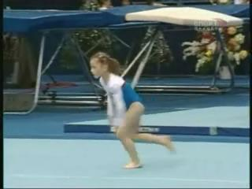
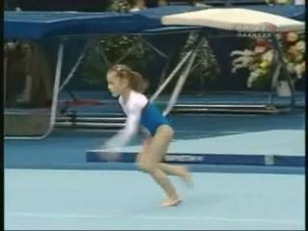
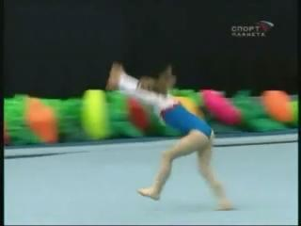
Previous Work
i) Trajectory-based Methods
ii) Supervoxel-based Methods
[Costeira&Kanade, Rao et al, Brox&Malik, Ochs&Brox, Fragkiadaki&Shi, … ]
[Brendel&Todorovic, Grundmann et al,
Vazques-Reina et al, Van den Bergh et al, …]
Space-time
over-segmentation
y
Cluster
motion trajectories
t
iii) Graph-based Methods
[Lee et al, Ma & Latecki, Zhang et al, Papazoglou et al,…]
x
Merge
regions
fg/bg votes
fg/bg votes
fg/bg votes
fg/bg votes
…
Propagate information

Slide 4
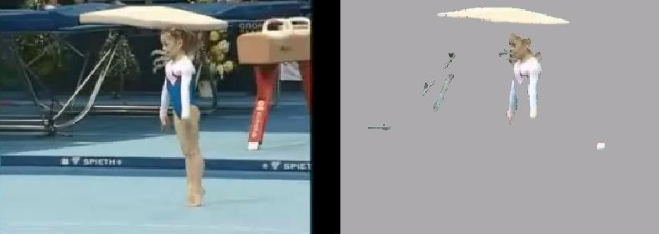
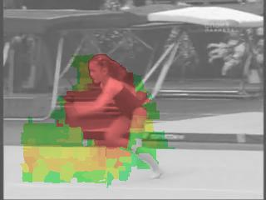
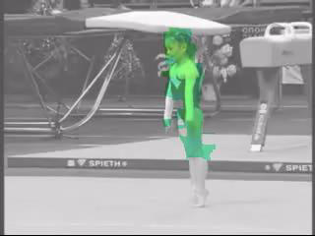
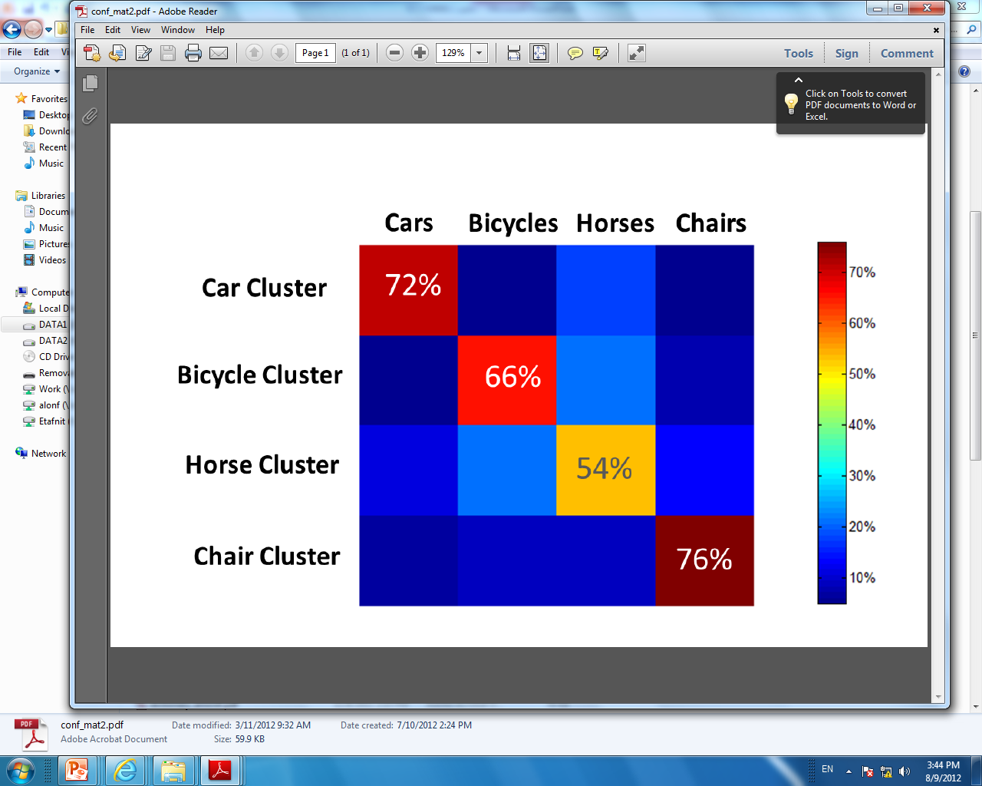
Previous Work
1. fg/bg initializations are very “noisy”
Do not handle well:
Non-rigid motions
Severe motion blur
Low quality video
fg
bg
iii) Graph-based Methods
[Lee et al, Ma & Latecki, Zhang et al, Papazoglou et al,…]
fg/bg votes
fg/bg votes
fg/bg votes
fg/bg votes
…
➔ only local temporal propagation
Propagate information
2. Optical flow is very noisy

Slide 5
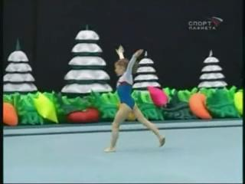
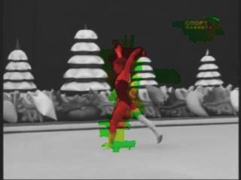
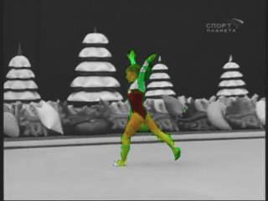
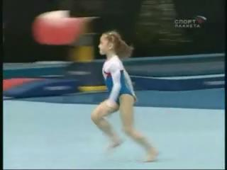
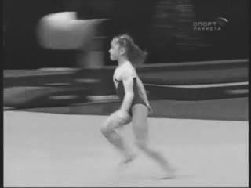
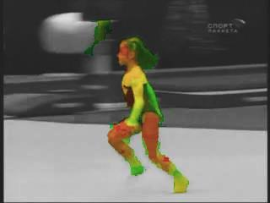
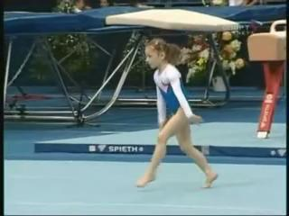
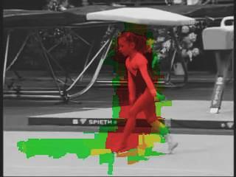
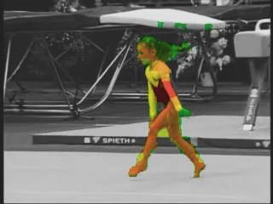
Our Approach:
Non-Local Propagation
in space and in time
…
…
Final fg/bg assignments
Noisy initial fg/bg votes
…
fg
bg
…
…
…
time
If >50% correct fg/bg votes ➔ recovers correct fg/bg assignments
Non-Local graph structure
in space and time
Cross-talk between
distant regions in the video
“Consensus Voting” of

Slide 6
Our Approach:
Non-Local Propagation
in space and in time
…
Final fg/bg assignments
Noisy initial fg/bg votes
fg
bg
…
time
If >50% correct fg/bg votes ➔ recovers correct fg/bg assignments
Non-Local graph structure
in space and time
Cross-talk between
distant regions in the video
“Consensus Voting” of

Slide 7
Step 1: Video Representation
Region Descriptor
Extract small regions
Color histogram
=
HOG
(Local structure)
Relative
position
Notes:
Now, lets describe the actual implementation steps.
First we extract superpixels for each frame by applying the watershed transform on the efficient boundary detector of Dollar et al from the recent ICCV. We use a low threshold for the boundary detection, resulting in a relatively large number of superpixels (around 1000-2000). This over-fragmentation allows us to extract meaningful boundaries even in the presence of high motion blur or low resolution.
We then represent each supepixel by several descriptors: color histograms, HOG and relative spatial location.
Thus, superpixels are close in this feature space if they have similar color and texture and do not move to far.
The last constraint helps to reduce foregorund background mix.

Slide 8
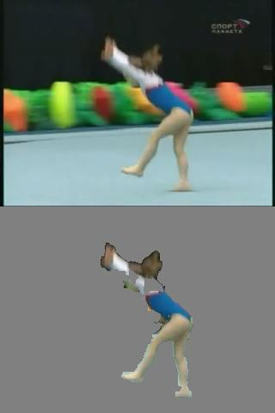
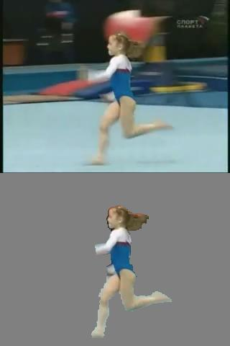
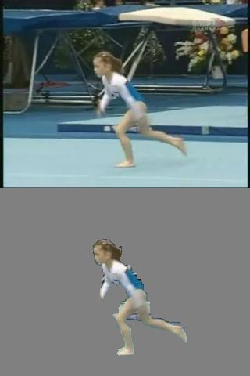
Step 2: Graph Construction
Look for NN in feature space
y
t
Non-local
graph structure
x
Notes:
We then augment all the superpixels into one large sparse graph by finding K nearest neighbours for each superpixel, where K is usually several dozens. For the search, we use a specialized scheme, which increases the fidelty of the NNs. This will be detailed later.

Slide 9
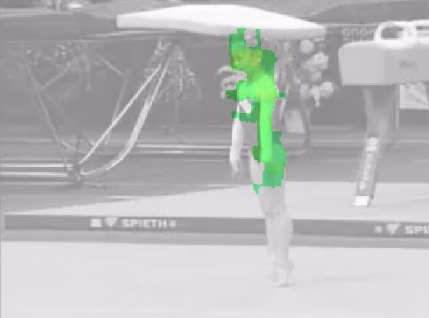
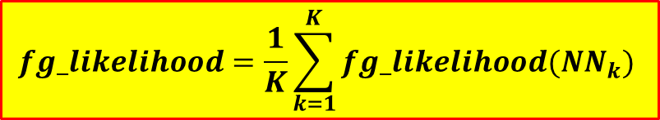
Step 3: Initialize Fg likelihood votes
Step 4: Consensus voting
Initial fg Likelihood
Final fg Likelihood
fg
$$fg_likelihood=\frac{1}{K}\sum_{k=1}^{K}{fg_likelihood({NN}_{k}) }$$
bg
0
fg Likelihood
1
Diffusing
Notes:
We then asccociate each superpixel with an initial foreground likelihood vote.
This is done by computing a motion saliency map for each frame.
Each node in the graph represnets a superpixel. Its color stands for its currnet foreground likelihood.
Red high likelihood, Orange, Yellow and Green lower likelhoods and grey very low likelihood.
We then perform consneus voting by diffusing the votes according to the graph of superpixels. Note how different clusters in the graph converge towards differnet values – allowing to separate between true foreground and background superpixels.
When going back to the video domain this is the final foregorund likelihood we get…

Slide 10
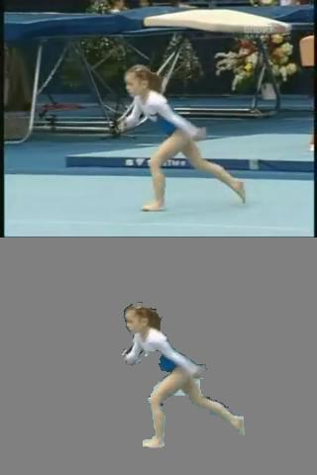
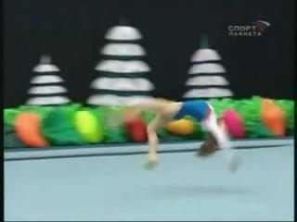
Initializing the fg likelihood votes
…
…
For each frame:
  Motion-based saliency
Coarse
optical-flow
Frame contains dominant motion?
Consistent flow ➔ Bg
Inconsistent flow ➔ Fg
Yes
No
Frame is ‘unreliable’
(set Fg votes to 0)
Appearance-based saliency
  [Margolin et al]
Not enough frames
Notes:
So the last detail left to descirbe is how we actually initialize the foreground likelihood votes.
We will first use motion saliency.
We compute optical flow for each frame.
We then check for each frame if is there exist “dominant” motion direction. This can be associated, with high likelihood, with background camera motion.
The first option is that the camera is static or nearly static – we can check this by examining the optical flow magnitude histogram in the frame.
The second option is that the camera is translating – we can check this by examining the optical flow orientation histogram in the frame.
If there indeed is dominant camrea motion, we compute for each pixel a saliency score with respect to dominant camrea motion.
If not, we set the entire forground likelihood in the frame to zero.
This frame selection mechanism makes sense, assuming that most videos contain enough frames with simple camera motion (almost static camera or translating), especially if long enough. Another advantage of this frame selection is that it filters out frames with unreliable optical flow, which may happen if the camera moves very fast.
But should we do if there are not enough frames with dominant camera motion?
One example when this happens is this video here. All the motions here are fully 3D and thus there will not be any frame with dominant camera motion. This kind of sequences require a different form of initilzation which is part of our current research.
Another case when this happens is when is there is non-rigid background motion. for example the waves in this video of a sea surfing. However, non-rigid backgrounds often tend to have quite repetitive structures. Thus in those cases we can resort to visual saliency, namely, detecting deviations from repetitive spatial structures

Slide 11


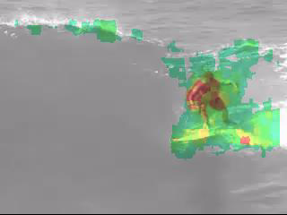
Initializing the fg likelihood votes
fg
bg
Motion-based Saliency
Appearance-based Saliency

Slide 12
Experiments
Comparison on the SegTrack Benchmark Dataset
➔ Significant improvement over state-of-the-art
SegTrack Benchmark (12 sequences) | Ours | Papazoglou et al 2013 | Zhang et al 2013
Average Segmentation Precision | 0.8 | 0.67 | 0.57
Runtime (per frame) | 12 sec | 15 sec | 3.5 min
(+20%)
(+40%)
[1] Papazoglou and Ferrari, ICCV’13
[2] Zhang, Javed and Shah, CVPR’13

Slide 13
Experiments
Comparison on the SegTrack Benchmark Dataset
➔ Significant improvement over state-of-the-art
Experiments on extremely difficult video sequences

Slide 14
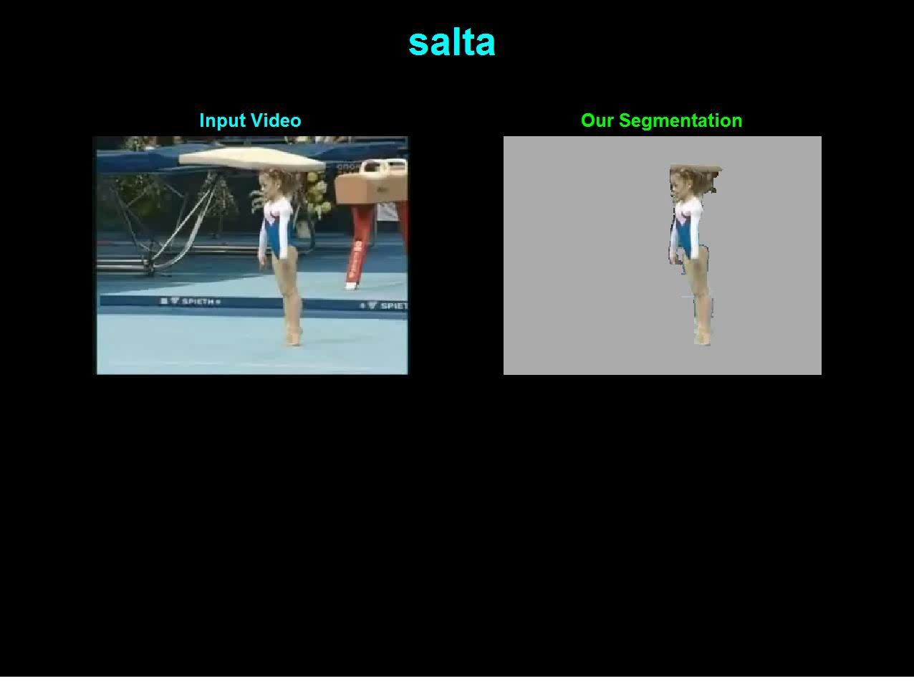

Slide 15
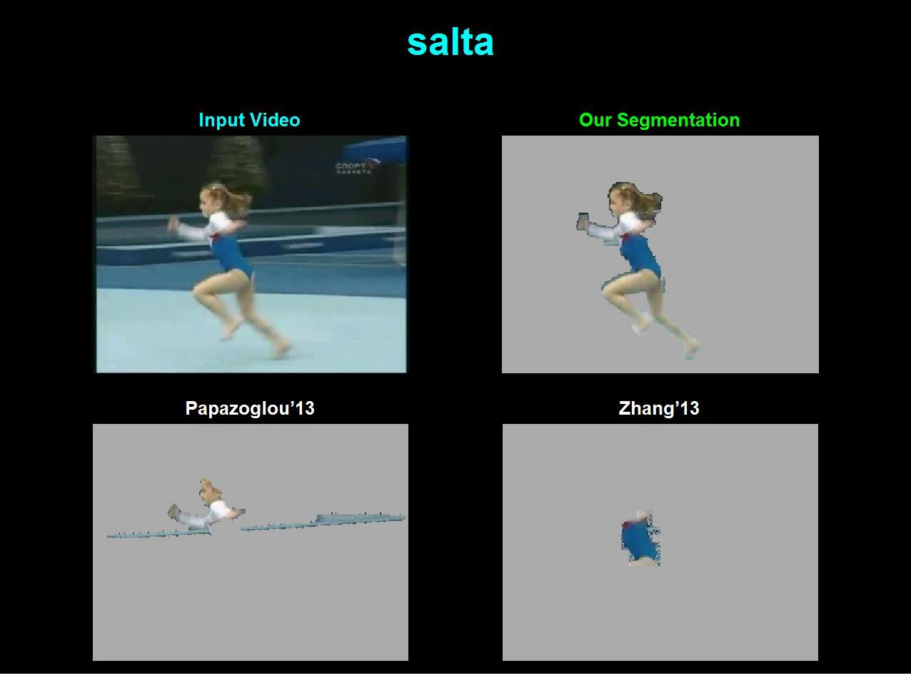

Slide 16
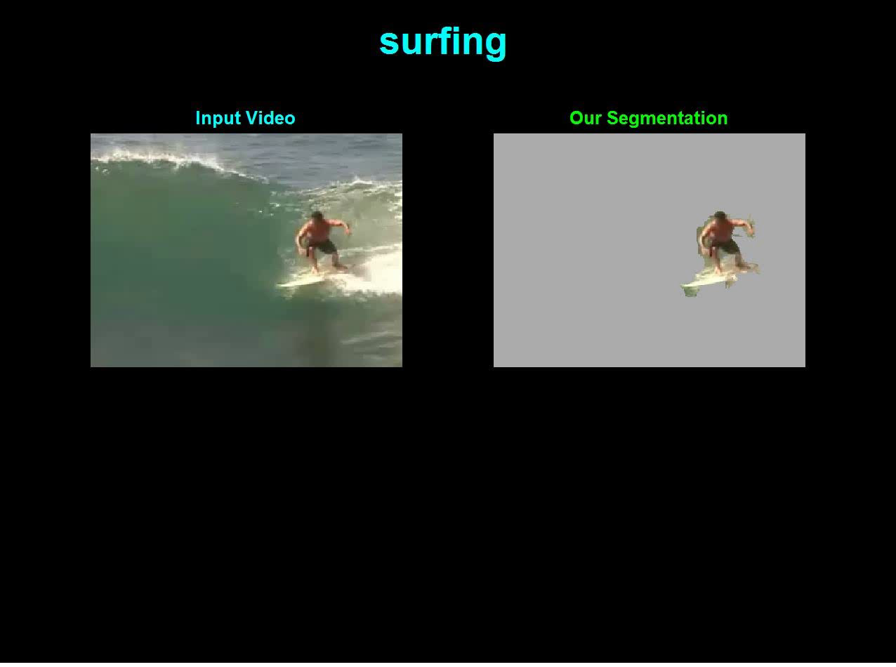

Slide 17
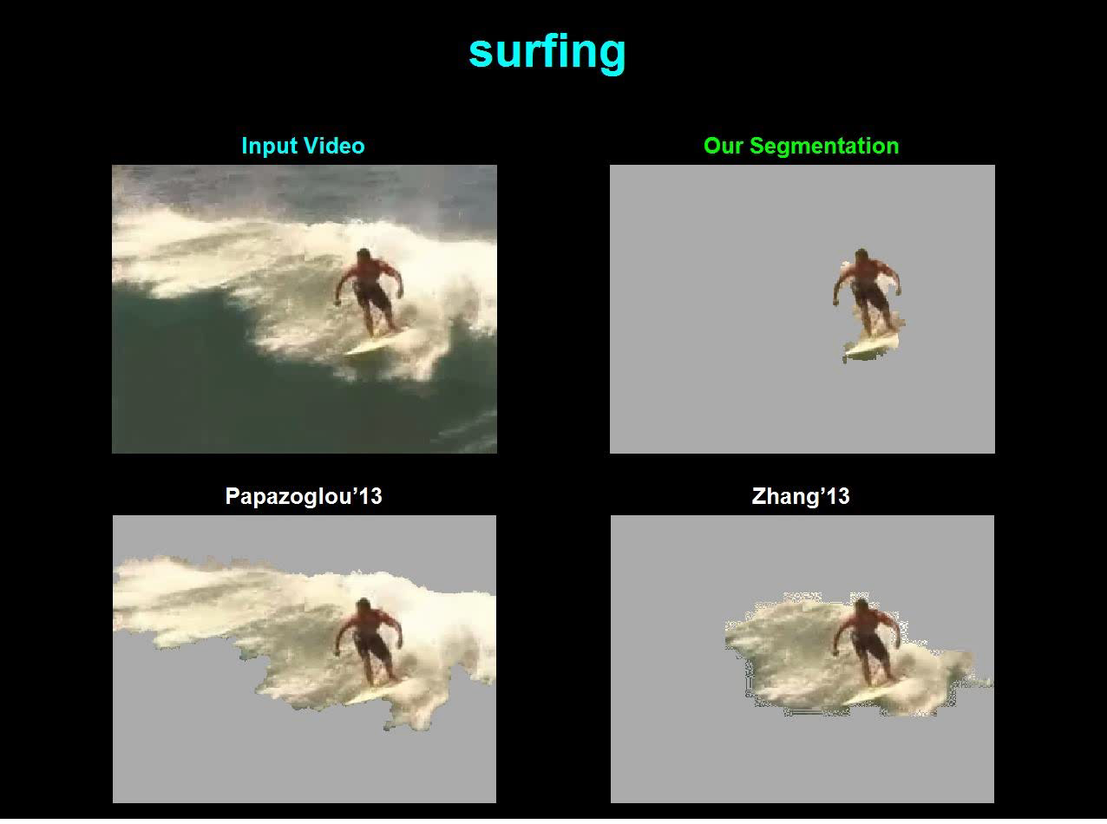

Slide 18
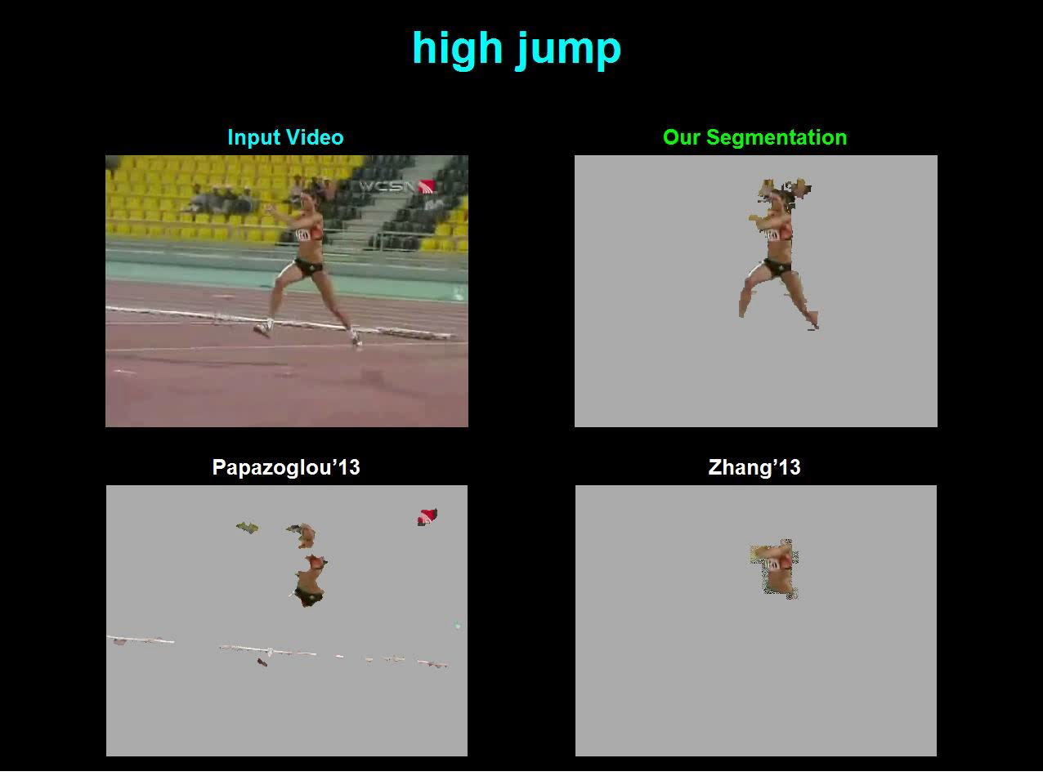

Slide 19
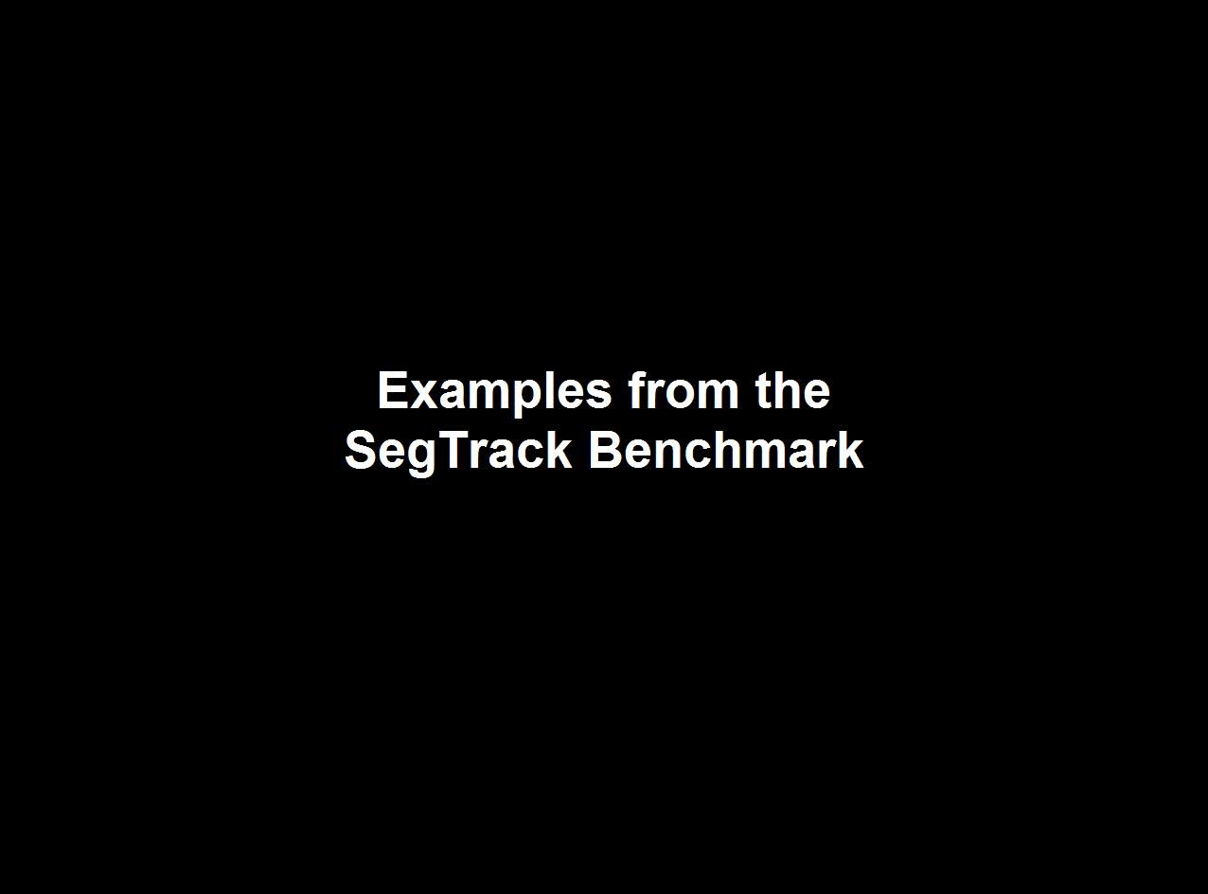

Slide 20
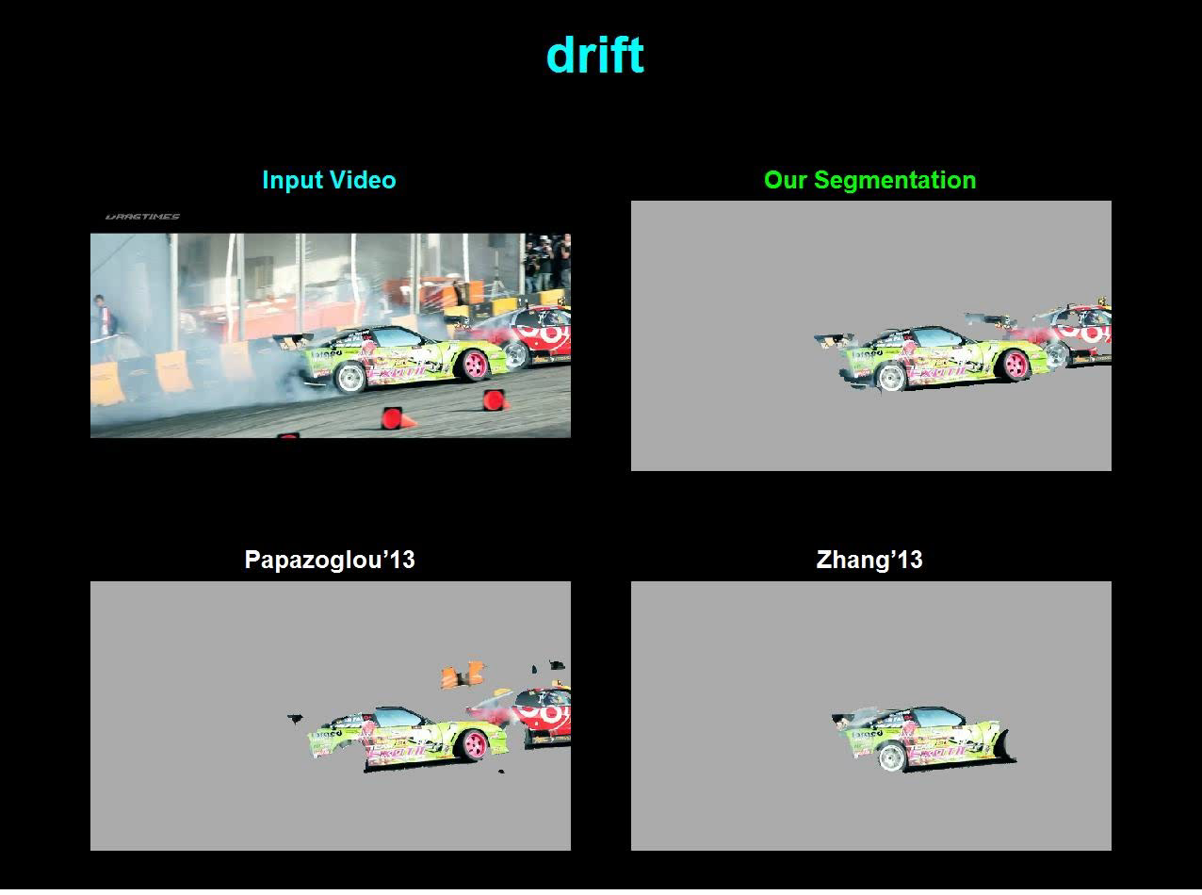

Slide 21
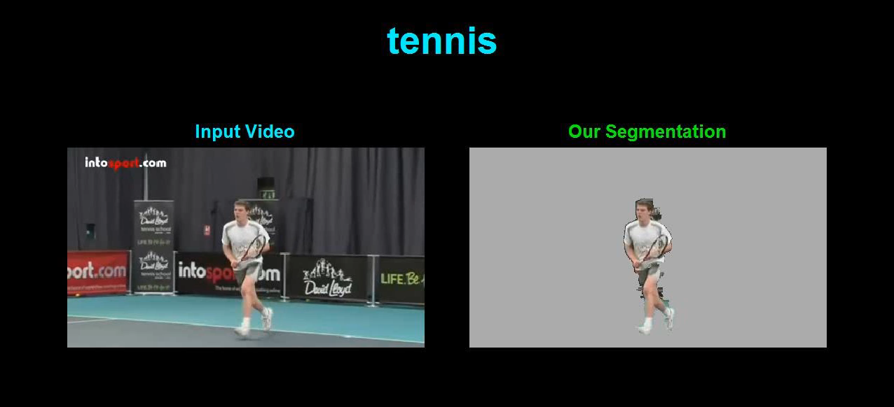
More Results

Slide 22
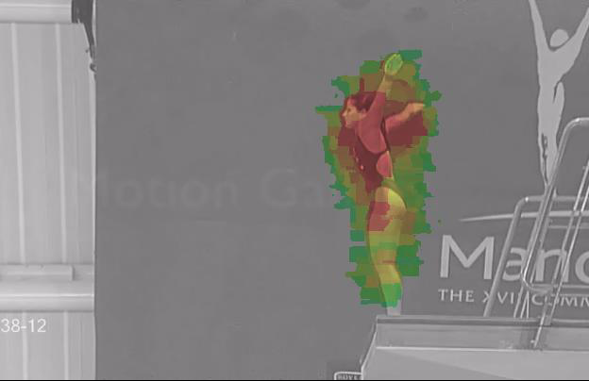
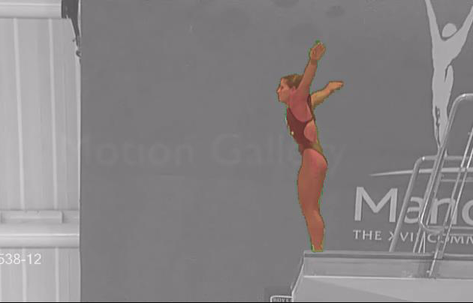
Summary
distant
Non-Local consensus voting of regions
➔ Propagates information far away in Space &Time
Very “noisy” initial fg/bg votes
converge to a good segmentation
3. Runtime is very fast
State of the art results
- Benchmark datasets
- New challenging sequences
Thank you!
Notes:
Lets conclude.
We saw how Finally, we obtain state-of-the-art results on the SegTrack benchmar datasets and got very encouraging results on new challenging sequences.
Thank you for your attention.

